Slide 1

Sikuli
www.pragmatic.bg
Lector: Dimitar Topuzov
E-mail: dtopuzov@gmail.com
LinkedIn: http://bg.linkedin.com/pub/dimitar-topuzov/18/470/833/en
Copyright © Pragmatic LLC 2018

Slide 2
Content
Theory
Demos with Sikuli IDE
Demos with sikulixapi and Java will be after we learn basics of Java testing.

Slide 3
What is Sikuli
Sikuli automates anything you see on the screen
Sikuli is cross platform and works on Windows, Linux and macOS
It uses image recognition to identify and control GUI components powered by OpenCV
Comes with basic text recognition (OCR) powered by Tesseract

Slide 4
What it can do
Find element by given image
Including finding a picture inside another picture
Perform keyboard and mouse events

Slide 5
What it can not do
Automate something that is not visible on the screen
For example real mobile devices (unless you have something like VNC session to device projected on the screen)

Slide 6

Who Develop Sikuli
Raimund Hocke (aka RaiMan) together with the open-source community

Slide 7

Who likes it
Neven Dinev
20+ years of experience
Great person

Slide 8
Resources
Web
http://www.sikuli.org/
http://sikulix.com/
Java API: http://nightly.sikuli.de/docs/index.html
Docs: http://sikulix-2014.readthedocs.io/en/latest/index.html#for-developers
GitHub
https://github.com/sikuli
https://github.com/RaiMan/SikuliX-2014

Slide 9

Sikuli and Python
A lot of articles like this explain that:
“ Sikuli is based on the Python language and ….”
This is NOT true !!!
This common mistake is caused by the fact that Sikuli IDE generates Jython scripts

Slide 10
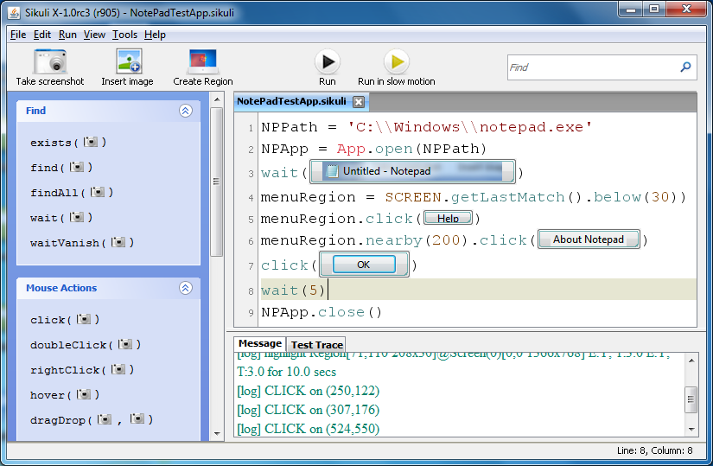
Sikuli IDE

Slide 11
Sikuli IDE
Intuitive open-source visual scripting tool
Record actions and generate Jython scripts
Jython != Python
Jython is an implementation of the Python programming language designed to run on the Java platform.

Slide 12
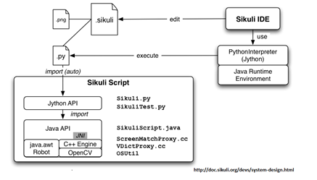
Sikuli IDE

Slide 13
Jython
Advantages
Looks easy as Python (actually it looks as Python)
Disadvantages
It require JVM
Latest release is more than year ago
No good support in IDEs

Slide 14

sikulixapi
Sikuli can be used in Java via sikulixapi maven package

Slide 15
Sikuli Tips
Pictures taken on 32-bit color might fail if you execute test on 16-bit color
Do not use compression when save image
It will modify some pixels and file might fail
Default tools on OSX apply some compression on png

Slide 16
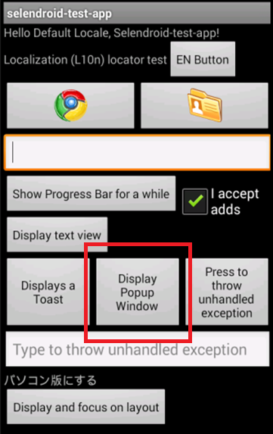
Sikuli Tips
Find Display Popup Window
Get smallest possible area around text
Get the button and a little bit of the black area
…or just try OCR ☺

Slide 17
Sikuli and Mobile
Emulators and Simulators
Possible and easy
Downsides:
It is hard to run simulator and emulator tests in parallel (or two emulators in parallel) because they might not fit the screen

Slide 18
Sikuli and Mobile
Device
Not possible out-of-the-box since devices are not visible on your PC screen
However, it is possible with some extra effort
Option 1: VNC to device
Usually require jailbreak or it is paid

Slide 19
Sikuli and Devices
Option 2:
Use tool to take screenshots
Adb (for Android) or idevicescreenshot (for iOS)
Use Sikuli to locate element and calculate coordinates
Use tool to perform gesture on coordinates
Adb (for Android) and ??? (for iOS)
Android Solution: imsardine/sikuli-monkey

Slide 20
Sikuli and Devices
Option 3: Mix Sikuli and Appium
Use Appium to communicate with device, take screenshots and perform gestures
Use Sikuli to locate on take screen shot and calculate coordinates

Slide 21
The Main Challenge
Sikuli does not scale well for multiple devices
If you want to test on 10 devices you need 10 UI maps – one for each device.

Slide 22
The Main Advantage
Sikuli does not care about technology
Your test will not break if Apple decide to deprecate XCTest in favor of something else
Works on apps without accessibility
Games
Apps with custom UI components

Slide 23

Questions

